Slide 1
Hardware Hacking
Turning your Hardware Dreams into Reality
Jonathan Meed
3/19/2013

Slide 2
Obligatory Inspirational Quote
If it doesn’t look pretty it probably won’t work well
– Steven Lam

Slide 3
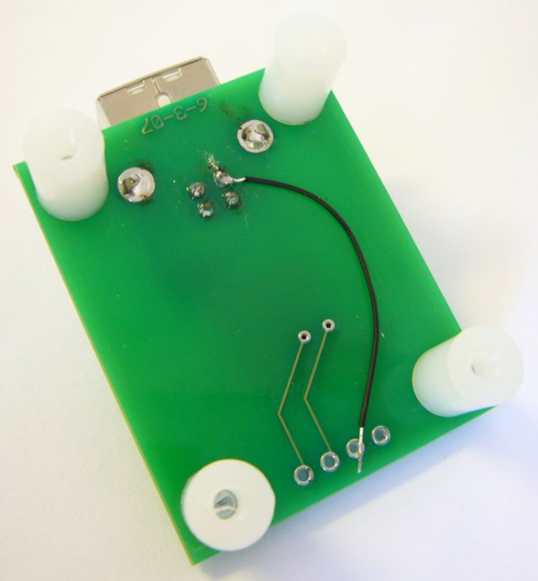
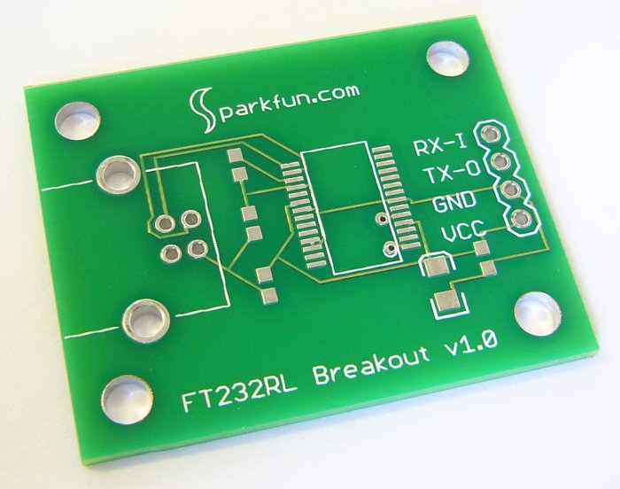
Parts of a PCB
Copper
(pads & traces)
Silkscreen
(white)
Soldermask
(green)
Via
Bottom side
Drill holes
This slide stolen from Prof. Brehob 373 Lecture

Slide 4
Your own PCB in 5 easy steps
Create Schematic
Layout Parts
Route Traces
Generate Gerber Files
Send to printer

Slide 5
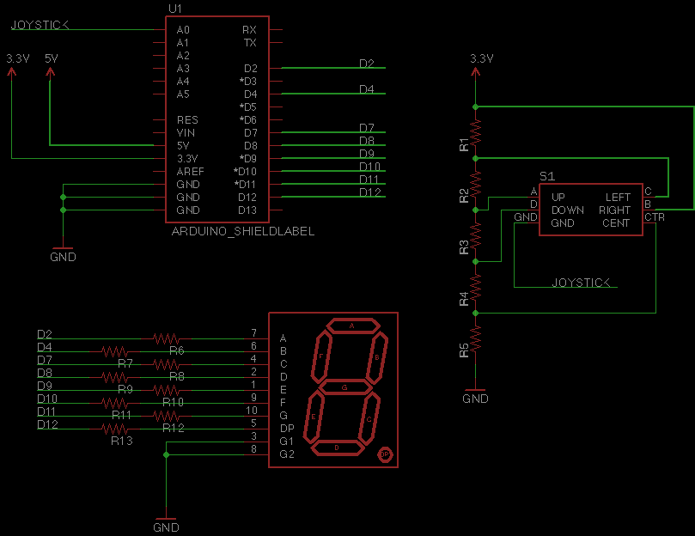
Todays Schematic

Slide 6


Schematic Quick Reference
Move
Copy
Rotate
Draw Net (wire)
Delete
Add Part
Draw Name
Change Name
Change Value
Download additional Libraries at http://github.com/sparkfun/SparkFun-Eagle-Libraries

Slide 7


Layout Quick Reference
Layers
Move
Route (wire)
Ripup (remove wire)
Flip
Rotate
Polygon
Via
Name
Ratsnest
Smash

Slide 8
Other Great Resources
SPL in 1625 BBB is a great resource
Sparkfun
Come to hack nights and ask questions
Email me at jmeed@umich.edu

